Slide 1

Health and Safety
The Community Team

Slide 2
Club and Society Activities
All sports clubs and societies must complete an annual Risk Assessment to cover your regular activities. This is to ensure you are providing a safe environment for your members and guests.
If you are hosting an activity which is different to your regular activities, you must fill complete an additional Risk Assessment, tailored to your new activity.
We are happy to give advice if you get stuck completing the Risk Assessment. Please work on this as a team so that more than one person on the committee understands the risks and knows how to manage them.
Please submit all completed Risk Assessments to your respective coordinator.
Societies - societies@su.arts.ac.uk
Sports- sports@su.arts.ac.uk.
Your Risk Assessment must be submitted at least 2 weeks before your activity!
2
Notes:
Speaker: Ny

Slide 3
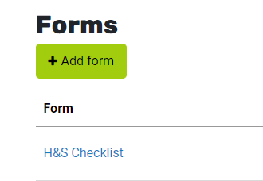
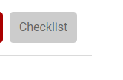
Society Activities
Societies ONLY!
You must submit the Health & Safety Form ‘Checklist’ on the Activities Dashboard declaring whether you are submitting an additional risk assessment or whether it is covered.
Activities that do not submit this form will not be approved!
3
Notes:
Speaker: Ny

Slide 4
Risk Assessment
A careful examination of your workplace to identify anything that could cause harm so that you can determine whether you have taken enough precautions or further controls measures are required
4
Notes:
Speaker: Aylin

Slide 5
What must a Risk Assessment cover?
Before, During & After:
  Setting up and dismantling of stalls/sports equipment
  Storage of items, equipment
  All activities and process involved in running them
Things to consider:
  Where are you going to set up/run the club?
  How much space do you need/have?
  What type of members are you expecting?
  Do you require members to be active?
  Does your activity/work/process create any hazards?
  Could your activity/work/process affect certain members?
5
Notes:
Speaker: Ny

Slide 6
Hazard
Something that has the potential to cause harm
6
Notes:
Speaker: Aylin

Slide 7
Risk Level
likelihood x severity
7
Notes:
Speaker: Aylin

Slide 8
Hazard or Risk?
Hazard or Risk?
Unstable ladder
Broken bones
Electrocution
Unprotected edge
Water spillage
Cross contamination
Live naked wire
Answer
Hazard
Risk
Risk
Hazard
Hazard
Risk
Hazard
8
Notes:
Speaker: Ny

Slide 9
Control Measures
Any measure taken to eliminate or reduce the risk of injury or bodily harm e.g. signage, physical restrictions, implemented policy or equipment repair.
9
Notes:
Speaker: Aylin

Slide 10
Prevent harm through safe design
Eliminate the harm
Substitute for something less harmful (or change the process)
Isolate people from the hazards. Create distance or barriers between people and the harm
Change the way you work (reduce exposure, provide instruction on safe work practices)
Use personal protective equipment
10
Notes:
Speaker: Ny

Slide 11
Control measures
Adverse weather – high winds, heavy rain thunderstorms – displays, gazebos knocked over | Ensure gazebos/sports equipment properly tied, displays secure Any ropes, pegs, supports clearly visible Extra ties, tape, weights to deal with unforeseen minor problems
Trip hazards, obstructions in escape routes - wires, boxes, materials | Maintain tidy cables, use ties, cable protector, if required Maintain good housekeeping – unwanted items under table
Trip hazards - table coverings trailing on ground | Position not to cause a trip hazard and ensure secure
Breakable items creating sharp dangerous edges | Ensure not placed at edge of table Safe means of clearing following any breakages/accidents
Inadequate hygiene whilst serving food, exposure to allergens | Ensure hygiene and food safety guidelines followed Ensure all allergens labelled
11
Notes:
Speaker: Ny

Slide 12
Control measures
Incorrect manual handling | Good technique used for manageable load – 2 person, if required Use aids to move heavier loads
Activities in extreme hot weather | Apply sun protection, sunglasses Appropriate clothing Sufficient drinks
Exposure to hazardous items | Any scissors, blades used for setting up put away to prohibit unauthorised use
Defective/non tested electrical equipment | Ensure all equipment maintained correctly and PAT in date prior to use
Incorrect working at height | Ladder training completed Appropriate ladders used
Violence, threatening behaviour, theft | Ensure familiar with local security procedures Handle any cash out of site
12
Notes:
Speaker: Ny

Slide 13
Completing a Risk Assessment
13
Notes:
Speaker: Ny

Slide 14
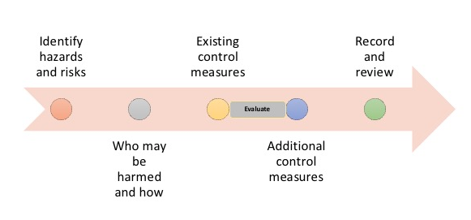
5 Steps to Your Risk Assessment
14
Notes:
Speaker: Ny

Slide 15
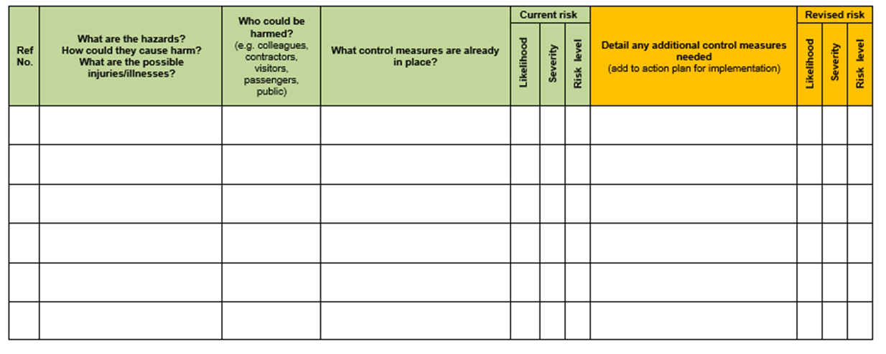
15
Notes:
Speaker: Ny

Slide 16
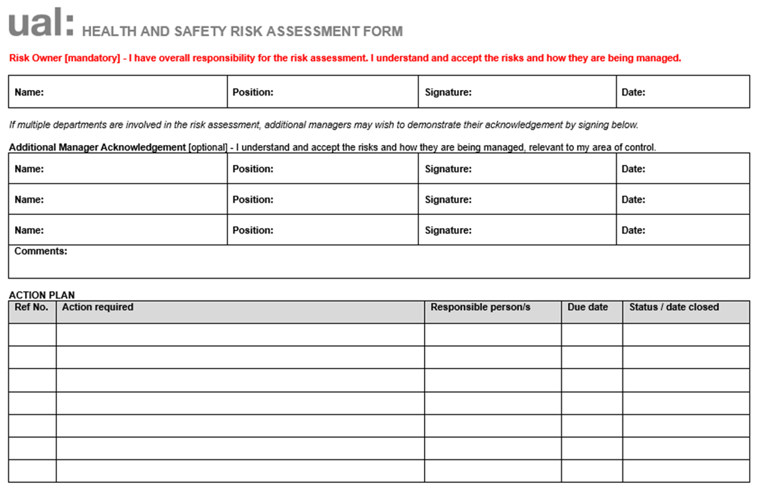
16
Notes:
Speaker: Ny

Slide 17
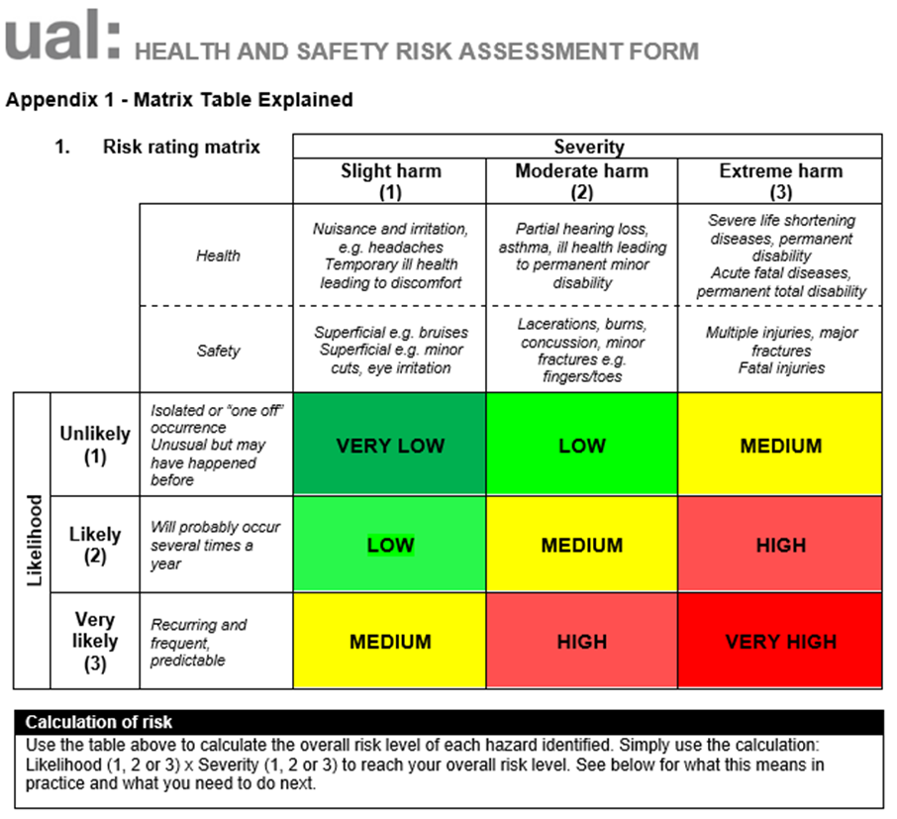
17
Notes:
Speaker: Ny

Slide 18
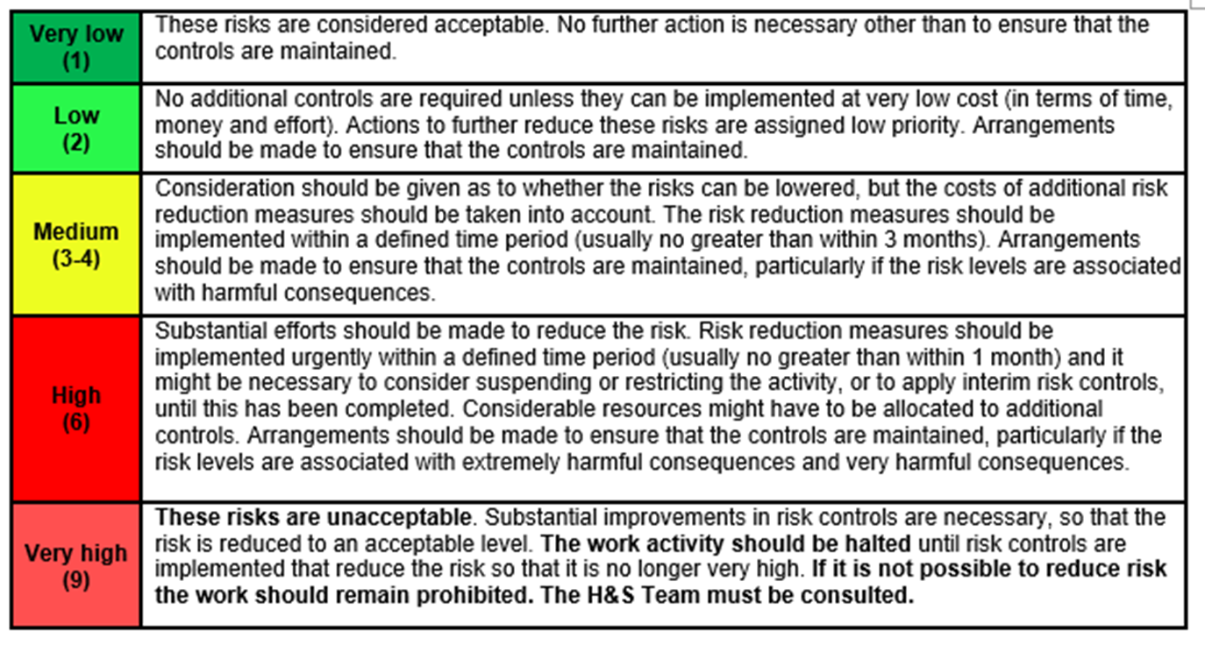
18
Notes:
Speaker: Ny

Slide 19
Suitable and Sufficient
All aspects of the event, activity, process have been considered
All those who may be affected have been considered/consulted(where appropriate)
All significant hazards have been dealt with
Precautions are reasonable and the remaining risk is low
Staff and/or representatives were involved in the process
19
Notes:
Speaker: Ny

Slide 20
Thank you

