Slide 1
Finance Training Sports Clubs and Societies
September
FY 2022-2023

Slide 2
Aims
Understand Arts SU financial procedures
Understand the PRF and how to submit a PRF
Understand the Supplier Invoice Policy
Understand how to submit an Invoice
Understand our financial year
Time-frames for submissions

Slide 3
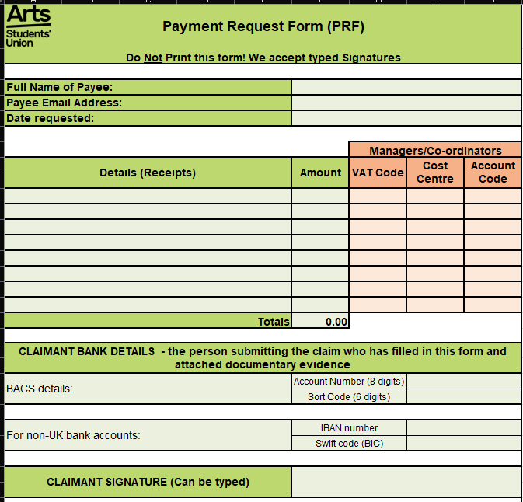

Slide 5
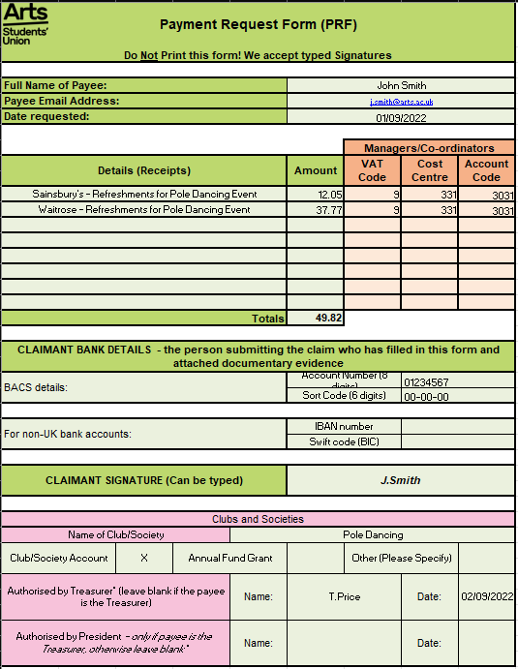
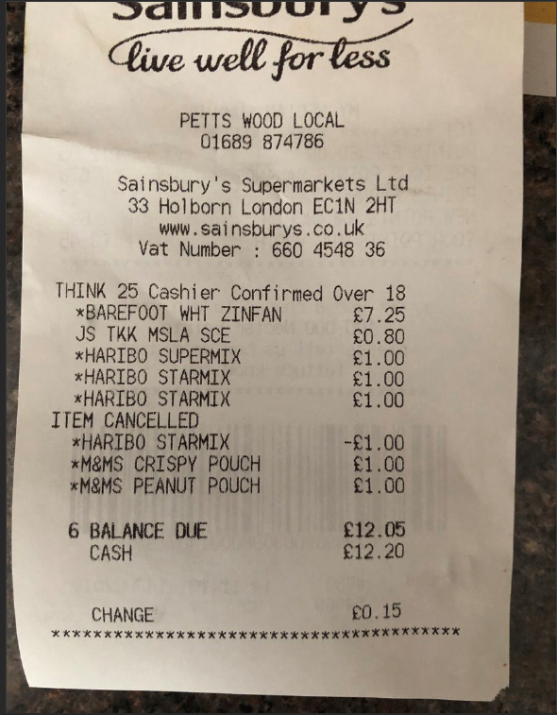
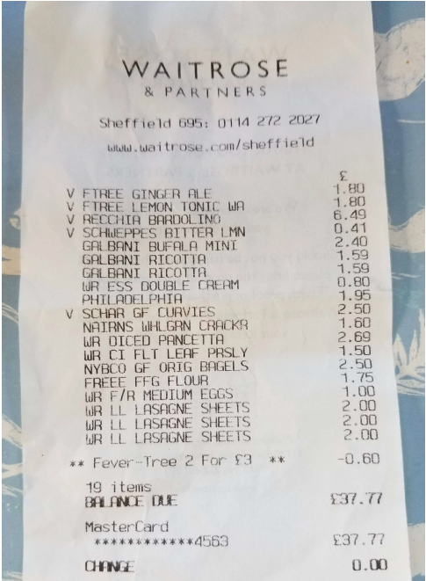
Receipt 1 – Sainsbury’s
Receipt 2 – Waitrose

Slide 6
How to submit a Payment Request Form
Agree the purchase with your treasurer prior to making it!
Step 1
Complete the Payment Request Form (PRF)
Clear description (what and why)
Bank details – try to use the same details
Step 2
Email your Treasurer the completed PRF with a copy of your receipt(s)
Please don’t attach an image but a PDF (Print to PDF). This helps avoid issues with picture size
Order your receipts to match the PRF. It will be reviewed multiple times. Make sure that they are in a clear order to ensure it gets paid quickly
Step 3
Treasurer will sign the PRF and email it to their Coordinator – Megan (societies) and Charlotte (sports clubs)
If the Treasurer is the one who has made the purchase and completed the PRF, please send the PRF and receipt(s) to the President to sign
President will send the completed PRF back to the Treasurer to send to their Coordinator
ALL FINANCIAL DOCUMENTS MUST BE SENT FROM THE TREASURER TO THEIR COORDINATOR!
Notes:
If you change banks then please notify us on the form!

Slide 7
Ensure your PRFs and receipts are...
Clear and understandable
The PRFs must be in Excel format
Receipt PDFs must be clearly labelled
Remember your bank details
Under £50!
Sent in the same month the purchase was made

Slide 8
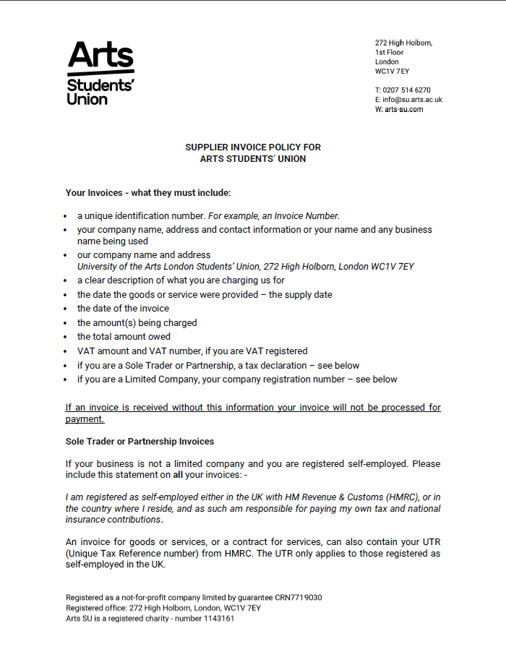
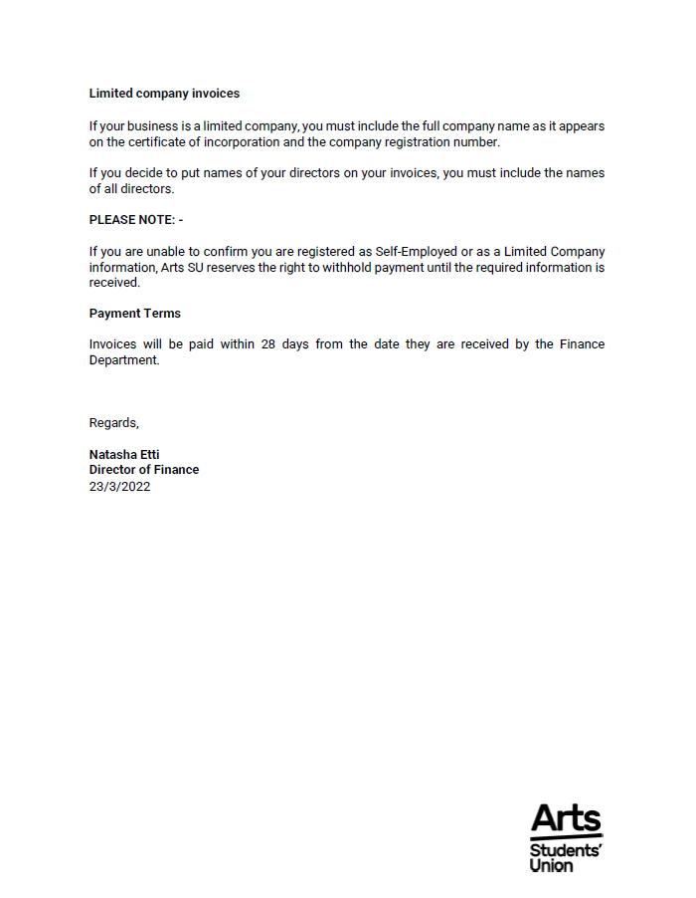

Slide 9
Invoice Requirements
The University of The Arts Students’ Union
272 High Holborn
London
WC1V 7EY
Follow the Supplier Invoice Policy 22-23
Correct Name and Address – this must include the Students’ Union
Invoice No.
Bank details
Name of Supplier
Company Registration Number or Self-employed tax statement
I am registered as self-employed either in the UK with HM Revenue & Customs (HMRC), or in the country where I reside, and as such am responsible for paying my own tax and national insurance contributions.

Slide 10
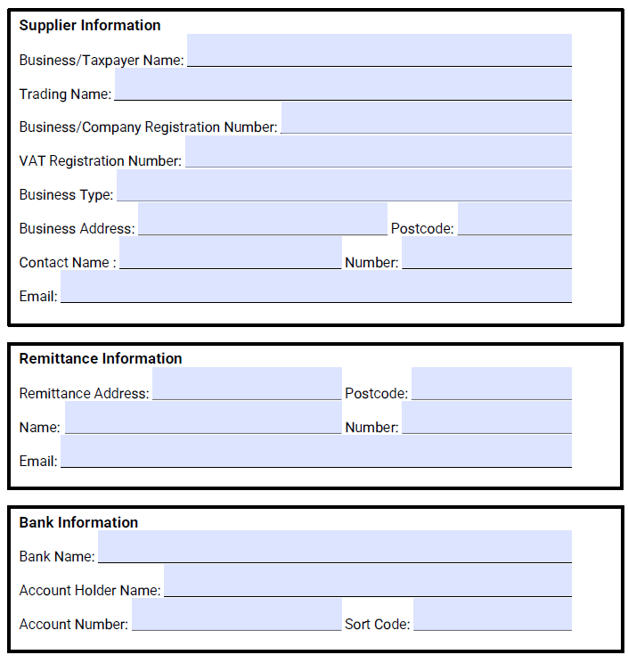
Send the Supplier Invoice Policy to the supplier along with the New Supplier form.

Slide 11
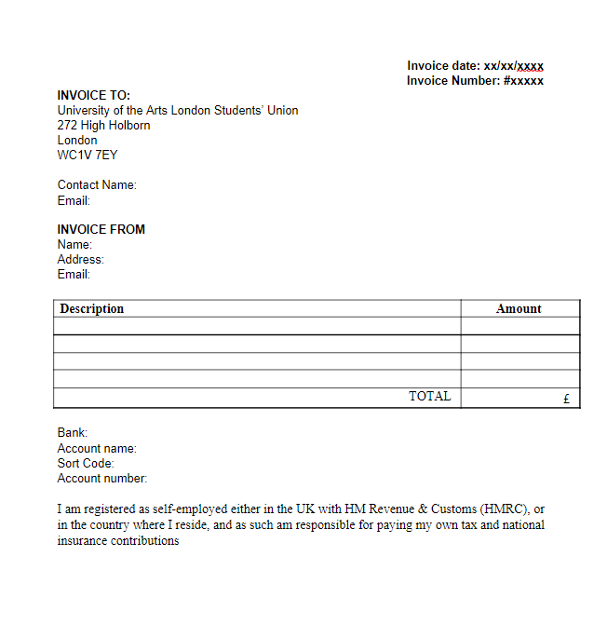
Suppliers may already have their own invoice templates, but if not, feel free to share our Invoice Template.

Slide 12
Submitting an Invoice
You receive an Invoice
Check the Invoice meets the Supplier Invoice Policy
Send it back to the supplier for amendments if you have a query or it doesn’t meet the policy standard
Review the amended Invoice
Send it to your Coordinator (Megan - societies, Charlotte – sports clubs) and state whether you want the money to come out of your private or grant account
Your Coordinator will review the Invoice and send it to Finance if the Invoice meets the Supplier Invoice Policy

Slide 13
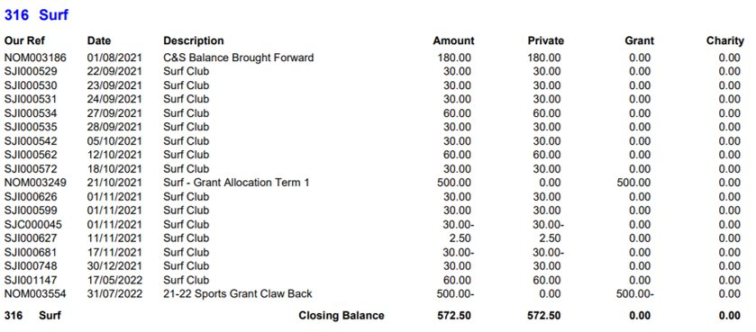
Allocating your purchase
Name ​
C&S Private​
C&S Grant ​
C&S Charity​
​

Slide 14
Private and Grant Account
PRIVATE
Non-restricted money
GRANT
Restricted money

Slide 15
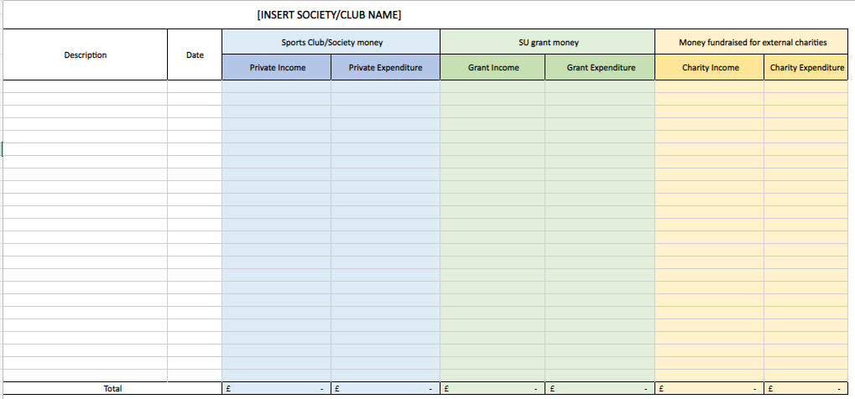

Slide 16
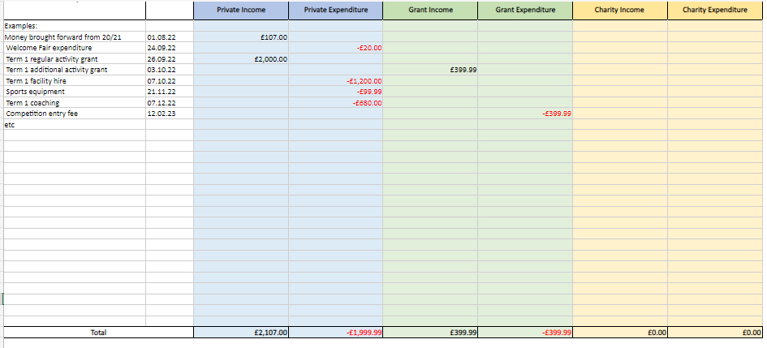
Remember to track income as positive and expenditure as negative!

Slide 17
Period/Year
Month / Year | Accounting System
Aug 2022 | 01/2022
Sep 2022 | 02/2022
Oct 2022 | 03/2022
Nov 2022 | 04/2022
Dec 2022 | 05/2022
Jan 2023 | 06/2022
Feb 2023 | 07/2022
Mar 2023 | 08/2022
Apr 2023 | 09/2022
May 2023 | 10/2022
Jun 2023 | 11/2022
Jul 2023 | 12/2022
Notes:
We follow the same structure as UAL

Slide 18
Why do we work by Period/Year?
To reflect an accurate financial position of your club or society
To ensure everything works by date “tax point”
Invoice/PRF must go in based on its date
Months get closed off!
Once closed we do not post to that period
If an Invoice is missed from a previous month it will appear in the next month
This will not completely reflect the accurate position of your account
Please send all incoming Invoices/PRFs by end of the month (one week grace period)

Slide 19
VAT
VAT does not apply when it comes to clubs and societies (out of scope)
The SU acts as a “bank” for each club or society meaning that any income is not the SU’s
We cannot reclaim any VAT on invoices from a club or society

Slide 20
Important Information
All invoices and PRFs will be processed and paid within 30 days of the SU receiving the completed documentation
Any invoice that does not meet our Supplier Invoice Policy cannot be paid until updated/correct invoice is received
PRF receipts/invoices older than 3 months will NOT be accepted
Any receipt without all the correct information will not be accepted

Slide 21
Where to find the financial documents
You can find the following forms on the Committee Resources Page:
Supplier Invoice Policy 22-23
New Supplier Form
Payment Request Form 22-23 (PRF)
Invoice Template

Slide 22
Summary
Receipts and Invoices must be clear and understandable
Download the new PRF for 22-23 from the Committee Resources Page
Always follow the Supplier Invoice Policy!
Send all Invoices/PRFs within the month they are dated

